Slide 1

APSIT Admission Management
System (Offline)
Chirag Padyal_20104034
Vishal Bangar_20104084
Jaykumar Nayi_20104005
Anuj Kundar_20104047
Project Guide
Ms. Jayshree Jha
Notes:
<number>

Slide 2
Contents
Introduction
Objectives
Scope
Features / Functionality
Project Outcomes
Technology Stack
Diagram
Notes:
<number>

Slide 3
1. Introduction
Our project topic in 2 points as follows
Problem Identified :
Educational institutions have to incur huge costs in maintaining academic records and have trouble in tracking bills and financial information.
Staff workload is heavy and resources are not optimized well to find the best students.
Solution Proposed :
An offline admission system lets the student apply for a course offline, submit mark sheets/documents, and check their application status through mail.
On the other hand, it allows the institutions to track the applicants, follow-up with them, accept digital documents, check eligibility, and create a cutofflist.
Notes:
<number>

Slide 4
2. Objectives
To Digitize the offline admission management system.
To track application status.
To automate the selection process.
To generate Student’s Personal Detail Report.
To Save Students and College management members Time.
To Mail the student on admission completion.
Notes:
<number>

Slide 5
3. Scope
Man Power Saving - Institutes don't need to allot additional manpower to manage heavy crowd.
Do not require printing & storing forms.
Does not require to collect forms of all the candidates and file them.
It is Rapid & Flexible.
Real-time reports for analysis.
Notes:
<number>

Slide 6
4. Feature /Functionality
The features & Functionality implemented are :
As a student, you can register & apply for offline admission by going to college for admission, the work process is faster and you will receive a mail on selection.
On acceptance of admission process, automatic transfer of details of the student to college register and college records without any paper work.
Students Details Like personal details, Login details, marksheet details and other details can be stored securely in a centralized system.
Notes:
<number>

Slide 7
5. Outcome of Project
The final Outcome of the Project is as follows :
Admin Can Login And Fill Student Form.
Student can apply for the admission.
Admins are able to access all the data.
Track application status of student through mail.
Generate Cutoff list Automatically.
Notes:
<number>

Slide 8
6. Technology Stack
Language Used :- Python.
API ( Application Programming Interface) :- Mysql-Connector-Python.
Framework :- PyQt5.
Database :- MySQL.
Notes:
<number>

Slide 9
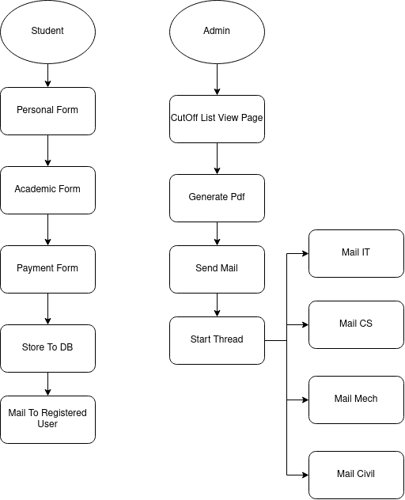
7. Diagram

Slide 10
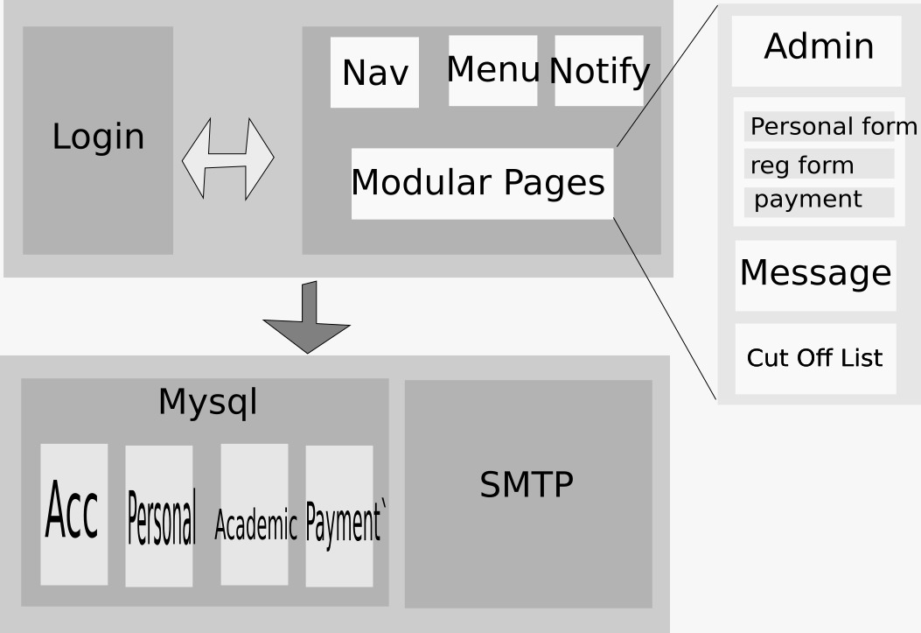
Notes:
<number>

Slide 11
Thank You...!!
Notes:
<number>

